Slide 1

Extension of SGLT-2 inhibitor – dual inhibitor
Professor Mike Cummings
Consultant Physician, Diabetes and Endocrinology
Portsmouth NHS Trust, UK

Slide 2
Disclosures
Professor Cummings has received research, educational grants or honoraria in an advisory capacity:
Boehringer Ingelheim, Lilly, Mylan, Sanofi, Novo Nordisk, Napp and Takeda, MSD

Slide 3
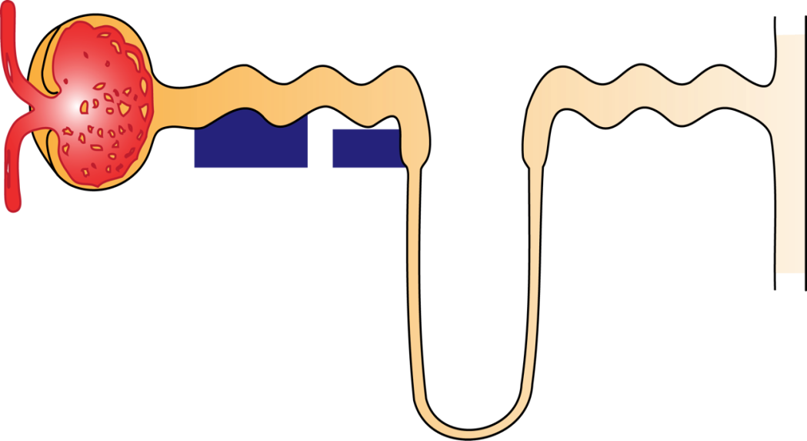
Renal glucose handling in the nephron of the healthy individual
Glomerulus
Proximal tubule
Distal tubule
Collecting duct
Glucose filtration
SGLT2
SGLT1
90%
10%
Glucose reabsorption
Loop of
Henle
Plasma glucose concentration: 5–5.5 mmol/L
Plasma filtered: 180 L/day
Glucose filtered: 160–180 g/day
Glucose excreted: Minimal
Minimal glucose excretion
SGLT: sodium–glucose co-transporter.
Figure adapted from: Bailey CJ. Trends Pharmacol Sci. 2011;32:63–71.

Slide 4
SGLT2 inhibition lowers the elevated renal threshold for glucose in type 2 diabetes¹
Glomerulus
Proximal tubule
Distal tubule
Collecting duct
Glucose filtration
SGLT2
SGLT1
Glucose reabsorption
SGLT2
inhibitor
Marked
increase in
glucose
excretion
Loop of
Henle
Plasma glucose concentration: 10 mmol/L
Plasma filtered: 180 L/day
Glucose filtered: ~320 g/day
Glucose excreted: ~70–119 g/day (equivalent to ~280–476 kcal/day)²⁻⁴
SGLT: sodium–glucose co-transporter.
Figure adapted from: Bailey CJ. Trends Pharmacol Sci. 2011;32:63–71.
1. DeFronzo RA et al. Diabetes Obes Metab. 2012;14:5–14; 2. Invokana (canagliflozin). Summary of Product Characteristics; 3. Jardiance (empagliflozin). Summary of Product Characteristics;
4. Forxiga (dapagliflozin). Summary of Product Characteristics. All SmPCs available at: https://www.medicines.org.uk/emc/ (accessed April 2018).

Slide 5
Overview of CVOT findings for SGLT2 inhibitors
EMPA-REG OUTCOME study¹
Adults with type 2 diabetes and established CV disease
CV death, non-fatal MI, or non-fatal stroke
CANVAS Program²
CV death, non-fatal MI, or non-fatal stroke
Placebo
20
HR 0.86
(95.02% CI: 0.74, 0.99)
p<0.001 for non-inferiority
p=0.04 for superiority
20
HR 0.86
(95% CI: 0.75, 0.97)
p<0.001 for non-inferiority
p=0.02 for superiority
Placebo
15
15
Patients with event (%)
Patients with event (%)
Canagliflozin
10
10
Empagliflozin
5
5
0
0
0
6
12
18
24
30
36
42
48
0
26
52
78
104
130
156
182
208
234
260
286
312
338
Months
Months
Patients at risk:
Empagliflozin
Placebo
4687
2333
4580
2256
4455
2194
4328
2112
3851
1875
2821
1380
2359
1161
1534
741
370
166
Patients at risk:
Canagliflozin
Placebo
5795
4347
5672
4239
5566
4153
5447
4061
4343
2942
2984
1626
2555
1240
2513
1217
2460
1187
2419
1156
2363
1120
2311
1095
1661
789
448
216
Zinman B et al. N Engl J Med. 2015;37:2117–2128. 2. Neal B et al. N Engl J Med. 2017;377:644-657.

Slide 6
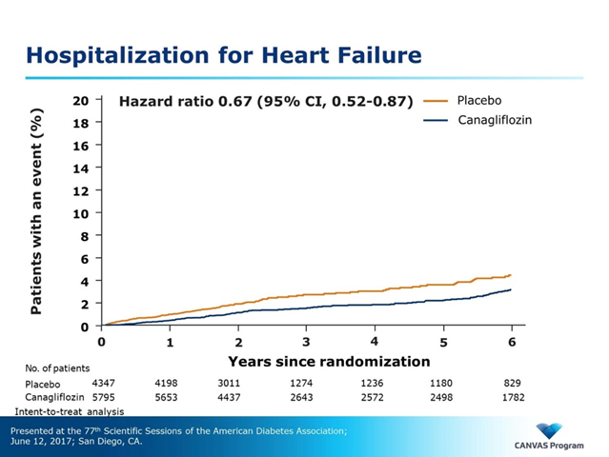
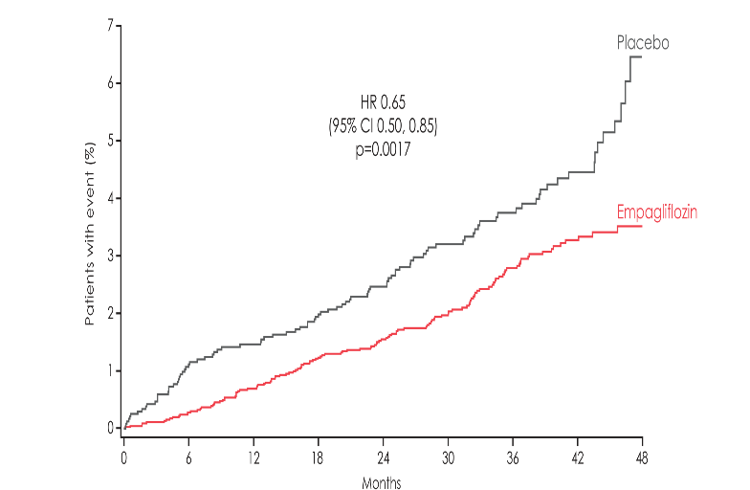

Hospitalisation for heart failure
Heart failure outcome with SGLT2 inhibitors
HR 0.65
(95% CI 0.50, 0.85);
p=0.002*
Notes:
Notes
An additional secondary endpoint assessed was HHF – defined as an admission to an inpatient unit or a visit to an emergency department that results in at least 12-hour stay for clinical manifestation of heart failure with the implementation of an additional/increased therapy
The rate for HHF was significantly lower in the empagliflozin group compared with the placebo group (p=0.002)
The HR was 0.65 for empagliflozin
The relative risk reduction was 35%
The absolute risk reduction was 1.4% based on HHF rates of 2.7% and 4.1% for empagliflozin and placebo
Absolute risk reductions were calculated from crude proportions
Abbreviation
HHF, hospitalisation for heart failure
Reference
Zinman B et al. N Engl J Med 2015;373:2117

Slide 7
Effect of intensive glucose lowering in recent trials
 | ACCORD¹ (n=10,251) |  |  | ADVANCE² (n=11,140) |  |  | VADT^{3,4} (n=1,791)
 | RRR | ARR |  | RRR | ARR |  | RRR | ARR
Primary CVD endpoint | ↓5% | ↓0.4% | p=0.16 | ↓6%* | ↓0.6%* | p=0.32* | ↓10% | ↓3.0% | p=0.14
Mortality (overall) | ↑26% | ↑1.0% | p=0.04 | ↓7% | ↓0.6% | p=0.28 | ↑8% | ↑0.9% | p=0.62
CV mortality | ↑43% | ↑0.8% | p=0.02 | ↓12% | ↓0.6% | p=0.12 | ↑32% | ↑1.0% | p=0.26
*combined macro and micro: RRR ↓10%, ARR ↓1.9%, p=0.01 *microvascular endpoint: RRR ↓14%, ARR ↓1.4%, p=0.01
Research Groups:
ACCORD: Action to Control Cardiovascular Risk in Diabetes
ADVANCE: Action in Diabetes and Vascular Disease
VADT: Veterans Affairs Diabetes Trial
Gerstein HC, et al. The ACCORD Study Group. N Engl J Med 2008;358(24):2545–2559.
ADVANCE Collaborative Group N Engl J Med 2008;358:2560–2572.
Duckworth W, et al. VADT Investigators. N Engl J Med 2009;360:129–139.
Duckworth W, et al. VADT Investigators. N Engl J Med 2009;360:129–139. Supplementary Appendix.

Slide 8
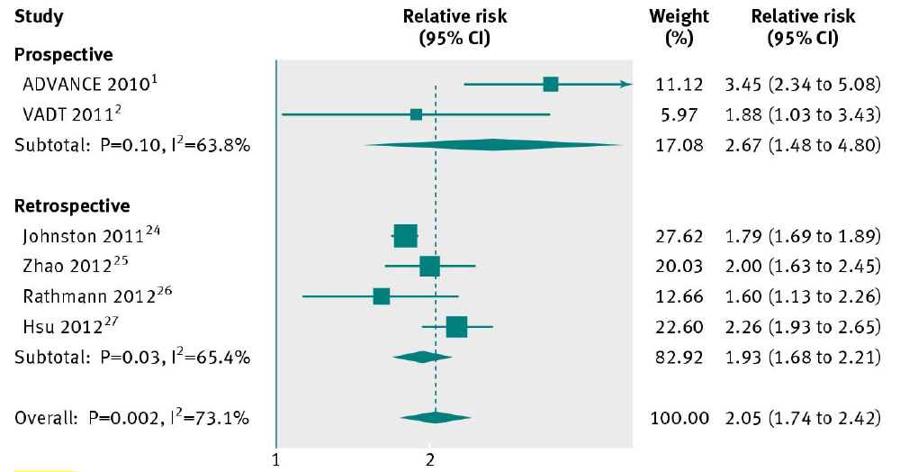
Severe hypoglycaemia may be associated with increased CV risk in patients with T2D
Meta-analysis including 903,510 participants, with 1–5.6 years of follow-up¹
RR for association between CVDª and severe hypoglycaemia in patients with T2D (95% CI)
1,2
3
4
5
6
7
ªCVD as an outcome was defined differently across the different trials
CI, confidence interval; CV, cardiovascular; CVD, cardiovascular disease; RR, relative risk; T2D, Type 2 Diabetes.
1. Goto A, et al. BMJ. 2013;347:f4533. 2. Zoungas S, et al. N Engl J Med. 2010;363:1410–1418 (ADVANCE 2010).
3. Duckworth WC, et al. J Diabetes Complications. 2011;25:355–361. 4. Johnston SS, et al. Diabetes Care. 2011;34:1164–1170.
5. Zhao Y. Diabetes Care. 2012;35:1126–1132. 6. Rathmann W, et al. Diabetes Obes Metab. 2013;15:55–61.
7. Hsu PF, et al. Diabetes Care. 2013;36:894–900.
Notes:
Notes
The slide shows the results of conventional random effects meta-analysis (which ignores unmeasured confounding) of data from 6 studies involving 903,510 participants with type 2 diabetes
The meta-analysis shows that severe hypoglycaemia was strongly associated with cardiovascular disease (relative risk, 2.05; 95% CI, 1.74 to 2.42; P<0.001)
Bias analysis indicated that severe comorbid illness alone may not explain the association between hypoglycaemia and CV disease
Reference
Goto A et al. BMJ. 2013;347:f4533
Abbreviations
ADVANCE, Action in Diabetes and Vascular Disease: Preterax and Diamicron Modified Release Controlled Evaluation; UKPDS, UK Prospective Diabetes Study; VADT, Veterans Affairs Diabetes Trial

Slide 9
Hypoglycaemia and CV risk: the possible links
Haemodynamic changes:
- activation of autonomic nervous system with
- 10-50 fold increased secretion of adrenaline and noradrenaline
ECG changes:
- longer QT interval
- hypokalaemia
Haemorheological changes:
- platelet activation
- increased viscosity
Diabetes Care. 2010 June; 33(6): 1389–1394
Notes:
9

Slide 10
SGLT2 inhibitors lead to dual inhibition
Glomerulus
Proximal tubule
G
G
Na+
G
G
G
Na+
Na+
Na+
G
G
SGLT2 inhibitor
G
G
Glycosuria
Na+
Natriuresis
SGLT: sodium–glucose co-transporter.
1. Figure adapted from: Bailey CJ. Trends Pharmacol Sci. 2011;32:63–71; 2. Heerspink HJL, et al. Circulation 2016;134:752–772.

Slide 11
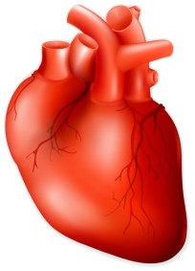
Glycosuria lowers HbA_{1c} and reduces glucose toxicity
↓ glucose toxicity
and
insulin resistance¹
↓ tissue inflammation
and
oxidative stress
↓ glucose
Potentially improving:¹⁻⁵
Endothelial function
Arterial wall structure
Cardiac function
1. Nolan CJ, et al. Diabetes 2015;64:673; 2. Inzucchi SE, et al. Diabetes Vasc Dis Res 2015;12:90; 3. Cahill PA, Redmond EM. Atherosclerosis 2016;248:97;
4. Cameron JD, et al. Vasc Health Risk Manag 2013;9:255; 5. Chilton R, et al. Diabetes Obes Metab 2015;17:1180.

Slide 12
Reduced risk of CV death was not associated with change in HbA_{1c} during the EMPA-REG OUTCOME study
Patients with event/analysed
Empagliflozin
Placebo
HR (95% CI)
p value
All patients
Change from baseline in HbA_{1c} at the last value in the trial
Any reduction
Increase or no change
Reduction of ≥0.3%
Reduction of <0.3% or increase
172/4687 (3.7)
109/2957 (3.7)
63/1728 (3.6)
97/2614 (3.7)
75/2071 (3.6)
137/2333 (5.9)
74/1158 (6.4)
63/1175 (5.4)
65/974 (6.7)
72/1359 (5.3)
0.62 (0.49, 0.77)
0.60 (0.44, 0.80)
0.64 (0.45, 0.91)
0.58 (0.42, 0.79)
0.65 (0.47, 0.90)
0.7744
0.5996
0.25
2.00
Post-hoc analysis. Cox regression analysis in patients treated with ≥1 dose of study drug.
P-values relate to tests of the homogeneity of treatment group differences among subgroups
(test for treatment by subgroup interaction) with no adjustment for multiple testing
CI, confidence intervals; HbA_{1c}, glycated haemoglobin.
Inzucchi S, et al. Poster presented at Diabetes UK Professional Conference, 14-16 March 2018, London, UK.
Favours
empagliflozin
Favours
placebo

Slide 13

Increased glucose excretion causes loss of total body fat mass
↓ calories / fuel
and
circulating insulin¹⁻³
↓ glucose
↑ rates of lipolysis¹⁻³
Lipolysis may lead to weight reduction and
potentially improve cardiometabolic risk¹⁻³
1. Rossmeislová L, et al. Int J Obes 2013;37:64;. 2. Heilbronn LK, et al. JAMA 2006;295:1539;
3. Dwyer JT, et al. in Endotext 2015; Ch 11. https://www.ncbi.nlm.nih.gov/books/NBK278991/#diet-treatment-obes.toc-11-summary-of-weight-loss-phase (accessed April 2018)

Slide 14
Empagliflozin H2H versus glimepiride: Change from baseline in visceral and subcutaneous fat at Week 104*
Glimepiride
(n=34)
Glimepiride
(n=34)
Empagliflozin
(n=39)
Empagliflozin
(n=39)
-22.2 cm²
(95% CI: -37.1, -7.4)
p=0.0039
-40.0 cm²
(95% CI: -58.9, -21.1)
p<0.0001
Mean (95% CI) change from baseline in
abdominal visceral adipose tissue (cm²)
Mean (95% CI) change from baseline in
subcutaneous adipose tissue (cm²)
Mean baseline (95% CI)
174.4 (143.3, 205.5) | 156.7 (138.6, 174.8)
Mean baseline (95% CI)
337.0 (297.8, 376.1) | 346.3 (312.5, 380.2)
CI, confidence interval; EMPA, empagliflozin; H2H, head-to-head
*Dedicated sub-study using magnetic resonance imaging; patient participation was optional.
Ridderstråle M, et al. Lancet Diabetes Endocrinol. 2014;2:691‒700. Supplementary appendix.

Slide 15
Reduced risk of CV death was not associated with
BP, LDL-cholesterol or HbA_{1c} control over time
Patients with event/analysed (%)
CV death
Empagliflozin
Placebo
HR (95% CI)
p value
Main analysis
Adjusted for time-dependent
control of BP*
Adjusted for time-dependent
control of LDL-C †
Adjusted for time-dependent
control of HbA_{1c} ‡
Adjusted for time-dependent
control of BP, LDL-C and HbA_{1c}
172/4687 (3.7)
172/4687 (3.7)
167/4615 (3.6)
172/4685 (3.7)
167/4614 (3.6)
137/2333 (5.9)
137/2333 (5.9)
136/2308 (5.9)
137/2333 (5.9)
136/2308 (5.9)
0.62 (0.49, 0.77)
0.61 (0.49, 0.76)
0.59 (0.47, 0.75)
0.62 (0.49, 0.78)
0.61 (0.48, 0.76)
<0.0001
0.25
1
4
Favours
empagliflozin
Favours
placebo
*(SBP <140 mmHg and DBP <90mmHg). †(LDL-cholesterol <100mg/dl). ‡(HbA_{1c}<7.5%).
Post-hoc analysis. Cox regression analysis in patients treated with ≥1 dose of study drug.
Main analysis did not adjust for baseline or time-dependent control of BP, LDL-cholesterol or HbA1c.
Fitchett D, et al. Poster presented at Diabetes UK Professional Conference, 14-16 March 2018, London, UK.

Slide 16
SGLT2i CVOT study results challenge the classical model of cardiovascular risk
Classic CV risk model¹
EMPA-REG OUTCOME study:
major adverse cardiac event (MACE)²
Hyperglycaemia
Insulin resistance
20
Empagliflozin 25 mg
HR 0.86 (95% CI: 0.73, 1.02)
p=0.09
Inflammation
Dyslipidaemia
Placebo
15
Infection
Thrombosis
Empagliflozin 10 mg
HR 0.85 (95% CI: 0.72, 1.01)
p=0.07
Patients with event (%)
10
Subclinical atherosclerosis
Pooled figures for Empagliflozin doses show a RRR of 14% and a ARR of 1.6% p=0.038
(p value for superiority)
5
Disease progression
0
Atherosclerotic events
0
6
12
18
24
30
36
42
48
Months
Acute and coronary syndromes,
stroke, peripheral artery disease
No. of patients:
Empagliflozin 10 mg
Empagliflozin 25 mg
Placebo
2345
2342
2333
2292
2288
2256
2233
2222
2194
2167
2161
2112
1918
1933
1875
1415
1406
1380
1177
1182
1161
753
781
741
178
192
166
1. Biondi-Zoccai GGL, et al. J Am Coll Cardiol 2003;41:1071–7; 2. Zinman B, et al. N Engl J Med 2015;373:2117–28.

Slide 17
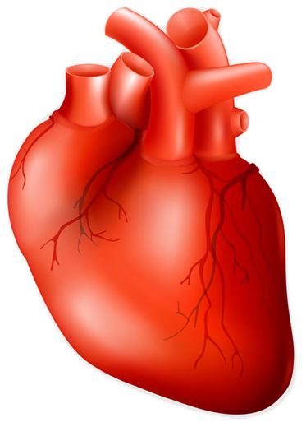
Multiple mechanisms may contribute to CV benefits with SGLT2 inhibitors
SGL2
inhibitors
Glycosuria¹
Natriuresis¹
Na⁺/H⁺
exchanger²
Reduced
HbA_{1c}
Reduced
total
body fat
Increased
uricosuria
Reduced
plasma
volume
Reduced
blood
pressure
Tubuloglo-
merular
feedback
Increased
mitochondrial
calcium
Reduced
HbA1c
Reduced
glucotoxicity
& inflammation
Ketone
utilisation
Reduce
oxidative
stress
Increased
haematocrit
Reduced
preload
Reduced
arterial
stiffness
Reduced
renal
damage
Reduced
glucotoxicity
& inflammation
1. Heerspink HJL, et al. Circulation 2016;134:752–72; 2. Baartscheer A, et al. Diabetologia 2017;60:568–73.

Slide 18
Multiple mechanisms may contribute to CV benefits with SGLT2 inhibitors
SGL2
inhibitors
Glycosuria¹
Natriuresis¹
Na⁺/H⁺
exchanger²
Reduced
HbA_{1c}
Reduced
total
body fat
Increased
uricosuria
Reduced
plasma
volume
Reduced
plasma
volume
Reduced
blood
pressure
Tubuloglo-
merular
feedback
Increased
mitochondrial
calcium
Reduced
glucotoxicity
& inflammation
Ketone
utilisation
Reduce
oxidative
stress
Increased
haematocrit
Reduced
preload
Increased
haematocrit
Reduced
preload
Reduced
arterial
stiffness
Reduced
renal
damage
1. Heerspink HJL, et al. Circulation 2016;134:752–72; 2. Baartscheer A, et al. Diabetologia 2017;60:568–73.

Slide 19
Natriuresis reduces plasma volume and may enhance oxygen delivery to the organs
↑ urine volume
↓ plasma volume
↑ oxygen delivery
to organs
↑ haematocrit¹
Potentially improving
cardiac function^{2–6}
1. Van Beaumont W. J Appl Physiol 1972;32:712; 2. Martini J, et al. Am J Physiol Heart Circ Physiol 2006;291:H310; 3. Salazar Vázquez BY, et al. Am J Respir Cell Mol Biol 2008;38:135;
4. Testani JM, et al. Circulation 2010;122:265; 5. Greene SJ, et al. Eur J Heart Fail 2013;15:1401; 6. van der Meer P, et al. J Am Coll Cardiol 2013;61:1973.

Slide 20
Natriuresis reduces plasma volume and reduces cardiac preload
↓ venous return
↓ cardiac preload
↓atrial pressure
↑ urine volume
↓ plasma volume
↓ myocardial
wall stretch
Potentially:
Improving cardiac function
Reducing risk of arrhythmia
1. McCullogh PA, et al. Contrib Nephro 2013;182:82; 2. Walters TE, et al. Circ Arrhythm Electrophysiol 2014;97:1189; 3. Kaseda S, et al. J Am Coll Cardiol 1988;11:1327;
4. Lip GY, et al. Eur J Heart Fail 2015;17:848; 5. Peyronnet R, et al. Circ Res 2016;118:311.

Slide 21
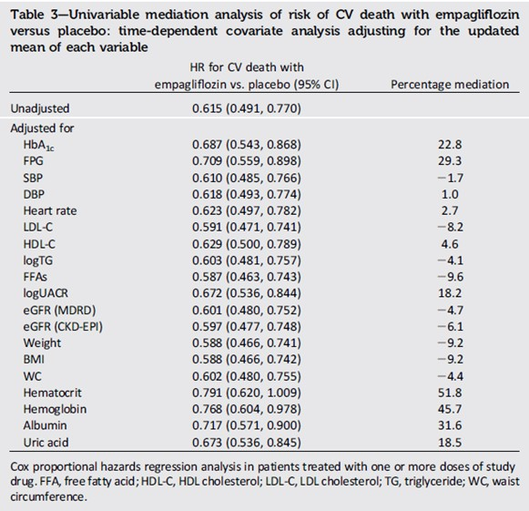
Plasma volume: mediation analysis
Exploratory analysis of EMPA-REG OUTCOME trials showed that changes in markers of plasma volume were most important mediators of the reduction in risk of CV death
Changes in hematocrit and haemoglobin mediated 51.8% and 48.9%, respectively, of the effect of empagliflozin v placebo on the risk of CV death on the basis of changes from baseline, with similar results in analyses on the basis of updated means (see table right) [Inzucchi 2018]

Slide 22
Multiple mechanisms may contribute to CV benefits with SGLT2 inhibitors
SGL2
inhibitors
Glycosuria¹
Natriuresis¹
Na⁺/H⁺
exchanger²
Reduced
HbA_{1c}
Reduced
total
body fat
Increased
uricosuria
Reduced
plasma
volume
Reduced
blood
pressure
Reduced
blood
pressure
Tubuloglo-
merular
feedback
Increased
mitochondrial
calcium
Reduced
glucotoxicity
& inflammation
Ketone
utilisation
Reduce
oxidative
stress
Increased
haematocrit
Reduced
preload
Reduced
arterial
stiffness
Increased
haematocrit
Reduced
preload
Reduced
arterial
stiffness
Reduced
renal
damage
Increased
oxygen
delivery
Reduced
myocardial
wall stretch
Additional CV benefits
1. Heerspink HJL, et al. Circulation 2016;134:752–72; 2. Baartscheer A, et al. Diabetologia 2017;60:568–73.

Slide 23
Lower plasma volume is expected to reduce blood pressure and decrease afterload
↓ arterial stiffness
and
endothelial injury^{1,2}
↑ urine volume
↓ plasma volume
↓ blood pressure
Potentially improving:
Endothelial function^{1,2}
Arterial wall structure / function^{2,3}
Cardiac function via decreased afterload^{2,4}
1. Chilton R, et al. Diabetes Obes Metab 2015;17:1180; 2. Cameron JD, et al. Vasc Health Risk Manag 2013;9:255;
3. Cahill PA, Redmond EM. Atherosclerosis 2016;248:97; 4. Inoue R, et al. Am J Hypertens 2012;25:568.

Slide 24
Reducing plasma volume may result in neurohormonal activation and influence risk of arrhythmia
Activate
RAS pathways^{1,2}
and SNS^{3,4}
↑ urine volume
↓ plasma volume
Neurohormonal
activation
RAS modulates vasoconstriction / vasodilation^{2,5}
RAS and SNS may influence risk of arrhythmia, and cardiac
and renal function either directly or via changes in blood flow^{4,6}
RAS, renin-angiotensin system; SNS, sympathetic nervous system.
1. Cherney DZ, et al. Circulation 2014;129:587; 2. Atlas SA, J Manag Care Pharm 2007;13(8 Suppl B):9; 3. Floras JS. J Am Coll Cardiol 2009;54:375;
4. Malpas SC. Physiol Rev 2010;90:513; 5. Muskiet MH, et al. Lancet Diabetes Endocrinol 2015;3:928; 6. Fink GD. Hypertension 2009;53:307.

Slide 25
Multiple mechanisms may contribute to CV benefits with SGLT2 inhibitors
SGL2
inhibitors
Glycosuria¹
Natriuresis¹
Na⁺/H⁺
exchanger²
Reduced
HbA_{1c}
Increased
uricosuria
Reduced
plasma
volume
Reduced
blood
pressure
Tubuloglo-
merular
feedback
Reduced
total
body fat
Tubuloglo-
merular
feedback
Increased
mitochondrial
calcium
Reduced
glucotoxicity
& inflammation
Ketone
utilisation
Reduce
oxidative
stress
Increased
haematocrit
Reduced
preload
Reduced
arterial
stiffness
Reduced
renal
damage
Reduced
arterial
stiffness
Reduced
renal
damage
Increased
oxygen
delivery
Reduced
myocardial
wall stretch
Additional CV benefits
1. Heerspink HJL, et al. Circulation 2016;134:752–72; 2. Baartscheer A, et al. Diabetologia 2017;60:568–73.

Slide 26













Diabetes causes glomerular hypertension
Na+/glucose co-transport
Afferent arteriole
SGLT2
GFR
SGLT2
SGLT2
PT
Glucose
Efferent arteriole
PT: Proximal tubule
GL: Glomerulus
MD: Macula densa
Loop of Henle
Renal haemodynamics under hyperglycaemia
Adapted from Cherney D, et al. Circulation 2014;129:587

Slide 27


SGLT2 inhibition attenuates glomerular hyperfiltration
SGLT2 inhibition
Afferent arteriole
SGLT2
GFR
SGLT2
SGLT2
PT
Glucose
Efferent arteriole
PT: Proximal tubule
GL: Glomerulus
MD: Macula densa
Loop of Henle
Renal haemodynamics with SGLT2 inhibition
Adapted from Cherney D et al. Circulation 2014;129:587

Slide 28
Multiple mechanisms may contribute to CV benefits with SGLT2 inhibitors
SGL2
inhibitors
Glycosuria¹
Natriuresis¹
Na⁺/H⁺
exchanger²
Reduced
HbA_{1c}
Reduced
total
body fat
Reduced
total
body fat
Increased
uricosuria
Reduced
plasma
volume
Reduced
blood
pressure
Tubuloglo-
merular
feedback
Increased
mitochondrial
calcium
Reduced
glucotoxicity
& inflammation
Ketone
utilisation
Ketone
utilisation
Reduce
oxidative
stress
Increased
haematocrit
Reduced
preload
Reduced
arterial
stiffness
Reduced
renal
damage
Reduced
renal
damage
Increased
oxygen
delivery
Reduced
myocardial
wall stretch
Additional CV benefits
1. Heerspink HJL, et al. Circulation 2016;134:752–72; 2. Baartscheer A, et al. Diabetologia 2017;60:568–73.

Slide 29
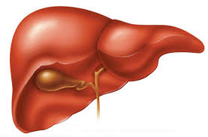
Free fatty acids + low insulin + high glucagon leads to increased ketogenesis
Lipolysis leads to increased free fatty acids
If low insulin and high glucagon:
Free fatty acids
Ketones
Ferrannini E, et al. Diab Care 2016;39:1108–14.

Slide 30
Chronic dosing of SGLT2i increases β-hydroxybutyrate in patients with Type 2 diabetes
T2D (n=66)
ND (n=25)
900
900
600
600
β-hydroxybutyrate
(µmol/L)
β-hydroxybutyrate
(µmol/L)
300
300
0
0
Baseline
-180
-120
-60
0
60
120
180
240
300
-180
-120
-60
0
60
120
180
240
300
Acute dosing
2000
2000
Chronic dosing
Meal
Meal
1600
1600
Lactate (µmol/L)
Lactate (µmol/L)
1200
100
800
800
0
0
-180
-120
-60
0
60
120
180
240
300
-180
-120
-60
0
60
120
180
240
300
Time (min)
Time (min)
Plasma β-hydroxybutyrate and lactate concentrations during the 3 h of fasting and the 5 h after meal ingestion at baseline and after acute and
chronic empagliflozin administration in patients with T2D (n=66) and subjects without diabetes (ND, n=25). Data after chronic dosing in subjects
without diabetes are from subjects with IGT only (n=13). Empagliflozin was administered at time -120 min. Plots are mean ± SEM
Ferrannini E, et al. Diabetes 2016;65:1190–5.

Slide 31
Ketones are a more efficient cardiac fuel source than glucose
Mitochondrial energetics of oxidation:
 | β-hydroxybutyrate | Glucose | Pyruvate
O2 used (L/mol) | 101 | 134 | 56
Heat of combustion (kcal/mol) | 487 | 670 | 279
O2 cost of calorie (mL/kcal) | 207 | 200 | 201
Heat of combustion per C₂ unit (kcal/mol) | 244 | 224 | 186
In terms of oxygen cost, the energy yield of β-hydroxybutyrate oxidation is comparable to those of glucose and pyruvate
If the energy yield is calculated per C₂ unit, β-hydroxybutyrate oxidation is superior to glucose and pyruvate
As a consequence, in the isolated working heart β-hydroxybutyrate increases external cardiac work at the same time as it reduces oxygen consumption, thereby improving cardiac efficiency by 24%
Ferrannini E, et al. Diab Care 2016;39:1108–14.

Slide 32
Multiple mechanisms may contribute to CV benefits with SGLT2 inhibitors
SGL2
inhibitors
Glycosuria¹
Natriuresis¹
Na⁺/H⁺
exchanger²
Reduced
HbA_{1c}
Reduced
total
body fat
Increased
uricosuria
Reduced
plasma
volume
Reduced
blood
pressure
Tubuloglo-
merular
feedback
Increased
mitochondrial
calcium
Ketone
utilisation
Reduced
glucotoxicity
& inflammation
Ketone
utilisation
Reduce
oxidative
stress
Increased
haematocrit
Reduced
preload
Reduced
arterial
stiffness
Reduced
renal
damage
Increased
oxygen
delivery
Reduced
myocardial
wall stretch
Additional CV benefits
1. Heerspink HJL, et al. Circulation 2016;134:752–72; 2. Baartscheer A, et al. Diabetologia 2017;60:568–73.

Slide 33
Direct cardiac effects through impairment of myocardial NHE flux, independent of SGLT2 activity in animal studies
↑ calcium in
myocardial
mitochondria
↓ intracellular sodium &
calcium in myocardium^{*1}
↓ sodium influx
to mitochondria
Calcium is needed for mitochondrial function
and may reduce reactive oxygen species (ROS)
production and increase ATP production
NHE, Sodium Hydrogen Exchanger
*In vitro evidence suggests that empagliflozin may have a direct effect to lower intracellular sodium concentrations in the myocardium via potentially inhibiting the
exchange of sodium and hydrogen between the myocyte and the blood.¹
1. Baartscheer A, et al. Diabetologia 2017;60:568–73.

Slide 34
Multiple mechanisms may contribute to CV benefits with SGLT2 inhibitors
SGL2
inhibitors
Glycosuria¹
Natriuresis¹
Na⁺/H⁺
exchanger²
Increase
uricosuria
Increased
mitochondrial
calcium
Reduced
HbA_{1c}
Reduced
total
body fat
Increased
uricosuria
Reduced
plasma
volume
Reduced
blood
pressure
Tubuloglo-
merular
feedback
Increased
mitochondrial
calcium
Reduced
glucotoxicity
& inflammation
Ketone
utilisation
Reduce
oxidative
stress
Reduce
oxidative
stress
Increased
haematocrit
Reduced
preload
Reduced
arterial
stiffness
Reduced
renal
damage
Increased
oxygen
delivery
Reduced
myocardial
wall stretch
Additional CV benefits
1. Heerspink HJL, et al. Circulation 2016;134:752–72; 2. Baartscheer A, et al. Diabetologia 2017;60:568–73.

Slide 35
Further hypotheses on the mechanisms of CV protection: uric acid
↑ uric acid excretion^{1,2}
↓ plasma uric acid^{3,4}
↓ cellular oxidative stress^{5,6}
↑ glucose excretion
May lead to improvements in:^{5,6}
Arterial wall structure / function
Cardiac function
1. Chino Y, et al. Biopharm Drug Dispos 2014;35:391; 2. Lytvyn Y, et al. Am J Physiol Renal Physiol 2015;308:F77; 3. Zinman B, et al. N Engl J Med 2015;373:2117;
4. Hach T, et al. ADA 2013. Poster 69-LB; 5. So A & Thorens B. J Clin Invest 2010;120:1791; 6. Feig DI, et al. N Engl J Med 2008;359:1811

Slide 36
Multiple mechanisms may contribute to CV benefits with SGLT2 inhibitors
SGL2
inhibitors
Glycosuria¹
Natriuresis¹
Na⁺/H⁺
exchanger²
Reduced
HbA_{1c}
Reduced
total
body fat
Increased
uricosuria
Reduced
plasma
volume
Reduced
blood
pressure
Tubuloglo-
merular
feedback
Increased
mitochondrial
calcium
Reduce
oxidative
stress
Reduced
glucotoxicity
& inflammation
Ketone
utilisation
Reduce
oxidative
stress
Increased
haematocrit
Reduced
preload
Reduced
arterial
stiffness
Reduced
renal
damage
Increased
oxygen
delivery
Reduced
myocardial
wall stretch
Additional CV benefits
1. Heerspink HJL, et al. Circulation 2016;134:752–72; 2. Baartscheer A, et al. Diabetologia 2017;60:568–73.

Slide 37
Known knowns or known unknowns: possible mechanisms responsible for the benefits of SGLT2 inhibition
On top of glycaemic lowering, SGLT2 inhibitors demonstrates additional clinical benefits versus placebo:
  Blood pressure lowering
  Weight loss
  Reduction in major cardiovascular events in patients with established cardiovascular disease¹
The mechanisms responsible for the cardiovascular effects are currently unknown
  May be a combination of natriuresis, glycosuria (dual inhibition) and/or Na⁺/H⁺ exchange
  Ongoing mechanistic studies may provide answers

